Slide 1
Drug Addiction Recovery Team
WELCOME
Name
City/Town
Have you ever heard of DART
Notes:
Dave

Slide 2
Meeting Agenda
What is DART and why do we do what we do
Physiology of addiction – Video
Break
Physiology of addiction as applied to DART
Break
The ABC’s of Recovery

Slide 3
Learning Objectives
Overall Goal – that participants leave this training with a better understanding of DART and SUD (Substance Use Disorder) than when they arrived
Learning Objectives:
Understand the core components of DART
Describe the personal and environmental factors that contribute to addiction
Explain the benefits of harm reduction, trauma informed care and empowerment approaches
Understand the non linear nature of recovery and multiple paths to recovery model
Notes:
Jump to next slide

Slide 4
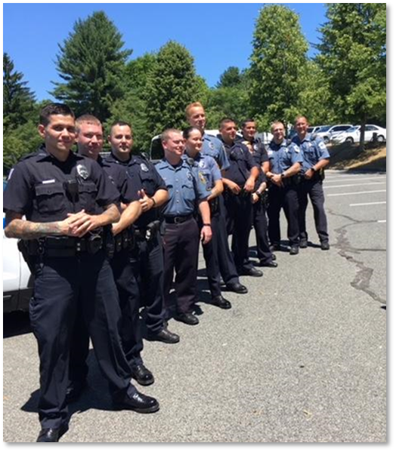
What is DART?
Law Enforcement/Public Health Partnership
LE responds to OD
Follows up the next day
Recovery Coach Outreach to those interested
Notes:
-Dave
Cindy asked us to do a SUD training. And that is what we are going to do. Nonetheless, we are going to use the DART program to explain SUD as well as some of the program choices we have made and why.
DART: Simple but not easy
-Police respond to OD and save a life
Enter it into our data base system
-Visit the person the next day in plain clothes. Check on the person and try to see if there are any services they are interested in.
If they are interested in a service, they refer to our recovery coaches who work with folks

Slide 5
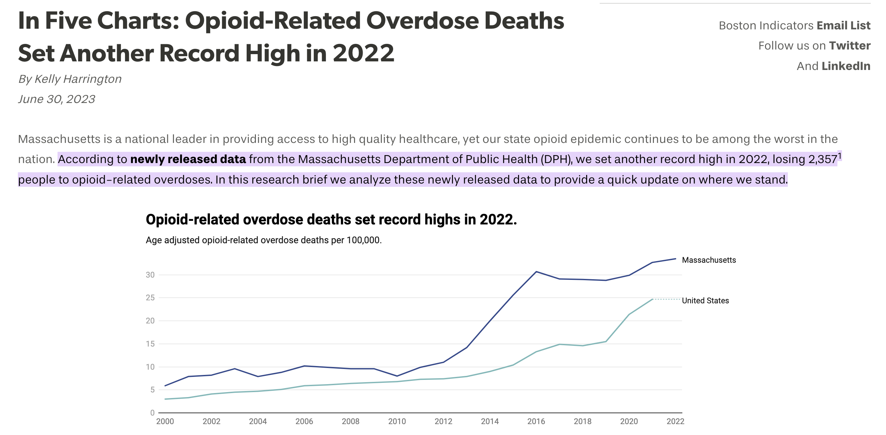
Why DART: People Are Dying From Opioids at HIGH RATES
Notes:
Why DART: the reason has been true since the start
Number aren’t reflecting that we are failing, reflecting a changing landscape

Slide 6
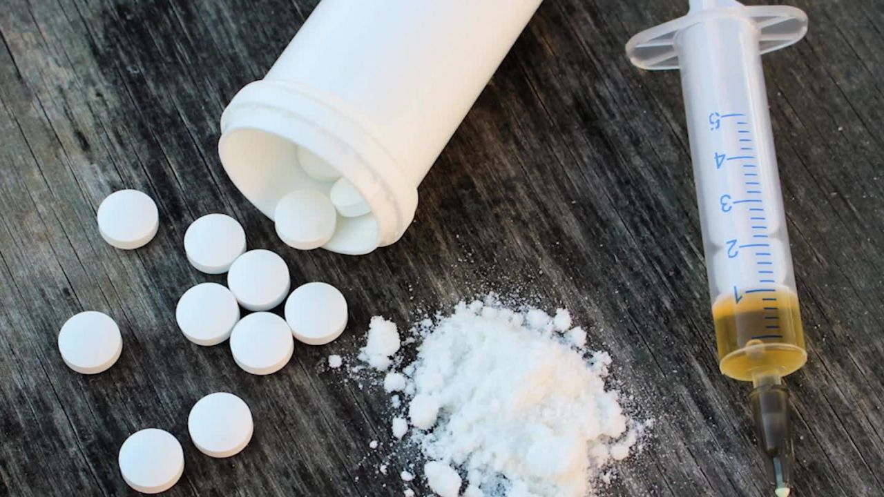
Fentanyl Slide
Notes:
The drug supply has changed
People who have used opioids for years without death now dying
We have youth who don’t have a SUD dying from counterfit pills
People are dying
The need for interventions, DART and beyond has increased

Slide 7
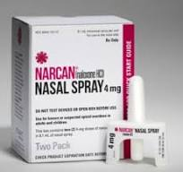
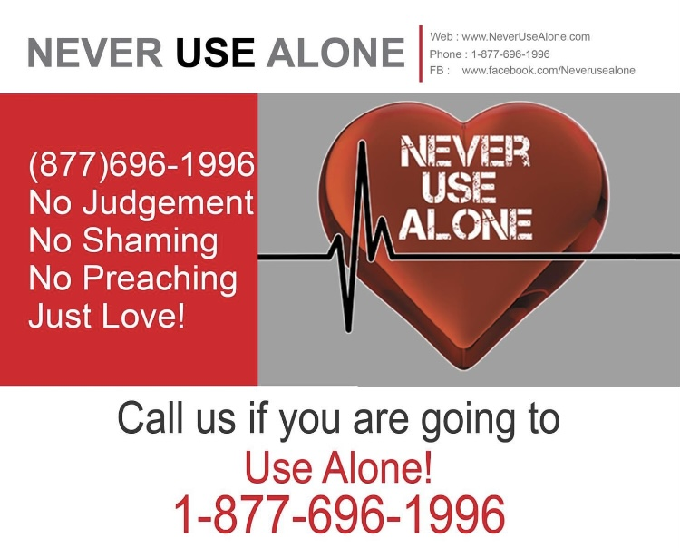
Why DART: These Deaths are Preventable
EVERY OVERDOSE DEATH IS PREVENTABLE
Notes:
We know people are dying, the goal of DART is to stop those deaths and it is possible.
It is very rare in public health or medicine to have a medicine that works as effectively as Narcan. Despite the fact that use of Narcan for an opiate overdose saves lives, people are still dying. We want to stop that

Slide 8
Why Police for DART?
Front lines
Know communities and its members
Police join force to HELP people

Slide 9
Why DART for Police?
De-escalate
Demonstrates unconditional care for all community members
EVERYONE IS AFFECTED BY SUD
Notes:
Dave story: throws folks off to see pd express concern and switch topic from convictions
Community policing which goes in and out of fashion is all about connecting with the community and demonstrating the reciprocal relationship between PD and community for many reasons number one to reduce crime and increase public perception of pd. When you see a DART officer working with a member of their community or their parents struggling with SUD, it would be hard to think anything negative of police. It helps with perception but also helps with future interactions.
Whatever your feeling about people who use substances remember that everyone that uses substances has family and friends. So helping that person doesn’t just help that person but it helps their support network. Plus DART also literally supports family and friends.

Slide 10
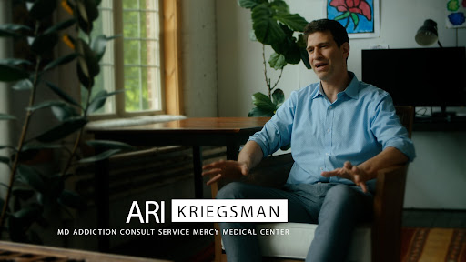
Physiology of Addiction
https://vimeo.com/725014624/d6f0d1e3ce
Notes:
-So we now know a bit about the cost of SUD, financial and personal, and why we are working with our esteemed PD. Before we can proceed with discussing what DART does and how it does it, we need to understand SUD a bit better because what we do and how we do it, truly is based on the disease itself. So we are going to watch this short video that we think is incredibly informative about this disorder, SUD
-Partner Exercise: Turn to person next to you and take turns sharing 2 things you learned from that video and how that learning may affect your work moving forward

Slide 11
Break

Slide 12
Physiology of Addiction for DART
ACES FROM CHILDHOOD STRONGLY AFFECT LIKELIHOOD OF ADDICTION
Kindness and empathy
BRAINS THAT USE SUBSTANCES ARE DIFFERENT THAN BRAINS THAT ARE NOT USING SUBSTANCES
Harm Reduction Philosophy
Anti Stigma/Non Judgmental
PEOPLE USING SUBSTANCES LOSE CONTROL OVER SO MANY ASPECTS OF THEIR LIVES
Consent
Respect
Empowerment
Trauma informed
Notes:
Kathi
I want to pull out the most important parts of that video for the DART program and connect it to DART values. From there we’ll take a break and when you come back, we’ll explore the details of each value more in depth.
ACES: if proclivity for SUD is determined by things that are out of ones control, DART really tries to understand that and approach people who are using drugs with curiosity and kindness. What’s this trauma informed thing? Trauma informed is just a recognition that many folks have trauma and you don’t know what it is so try to approach people with that understanding. Given the high aces we know people who use drugs have lots of childhood trauma. Then there is the trauma most folks experience from drug use. Please be kind.
Brains that Use Drugs are Different: Once you have started using drugs, it is so hard to stop. DART does two things in recognition of this fact.
1, harm reduction. Harm reduction is a series of practices that try to reduce the harm someone doing an unsafe behavior. Seat belt example. In SUD, harm reduction is Narcan.
Reduce stigma and shame. Shame and blame have no place and they aren’t helpful. If you shame someone for their substance use they will be less likely to seek help from you. Moreover, as Ari said, recovery is about fixing your brain and rejoining society so the more we shame and blame people the farther we push people out of society and into drugs.
Control: little control over urges, lose so much that we try to give folks back some control. We do it in a few ways: we try to ask as much as possible: may we come visit. Are you interested in a recovery coach. Fix power imbalances: first name.

Slide 13
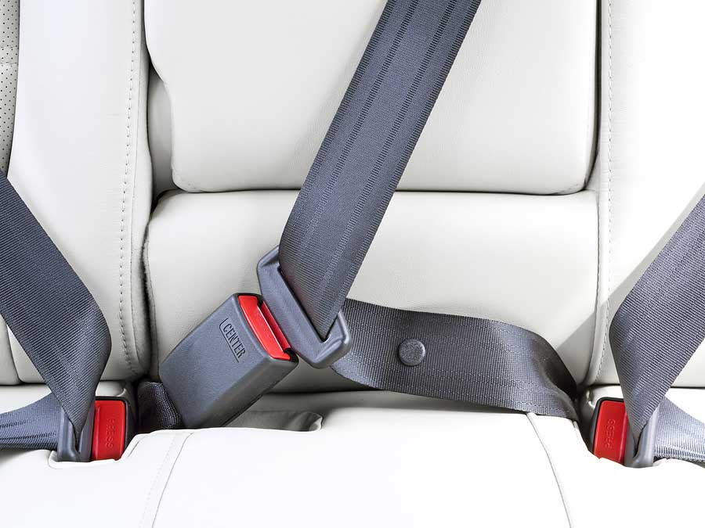

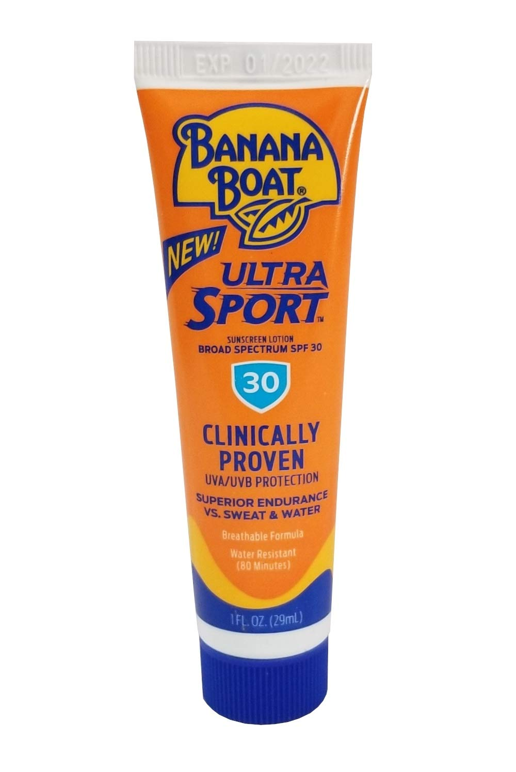
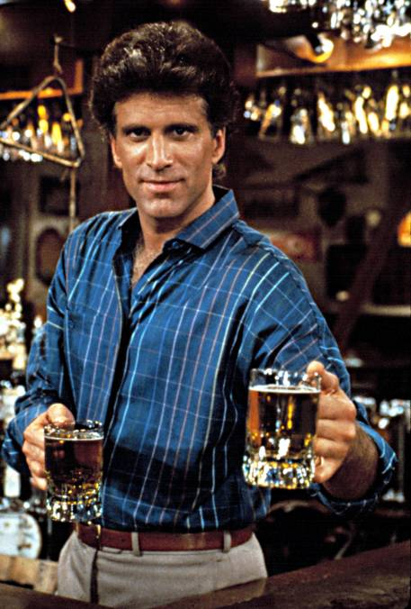
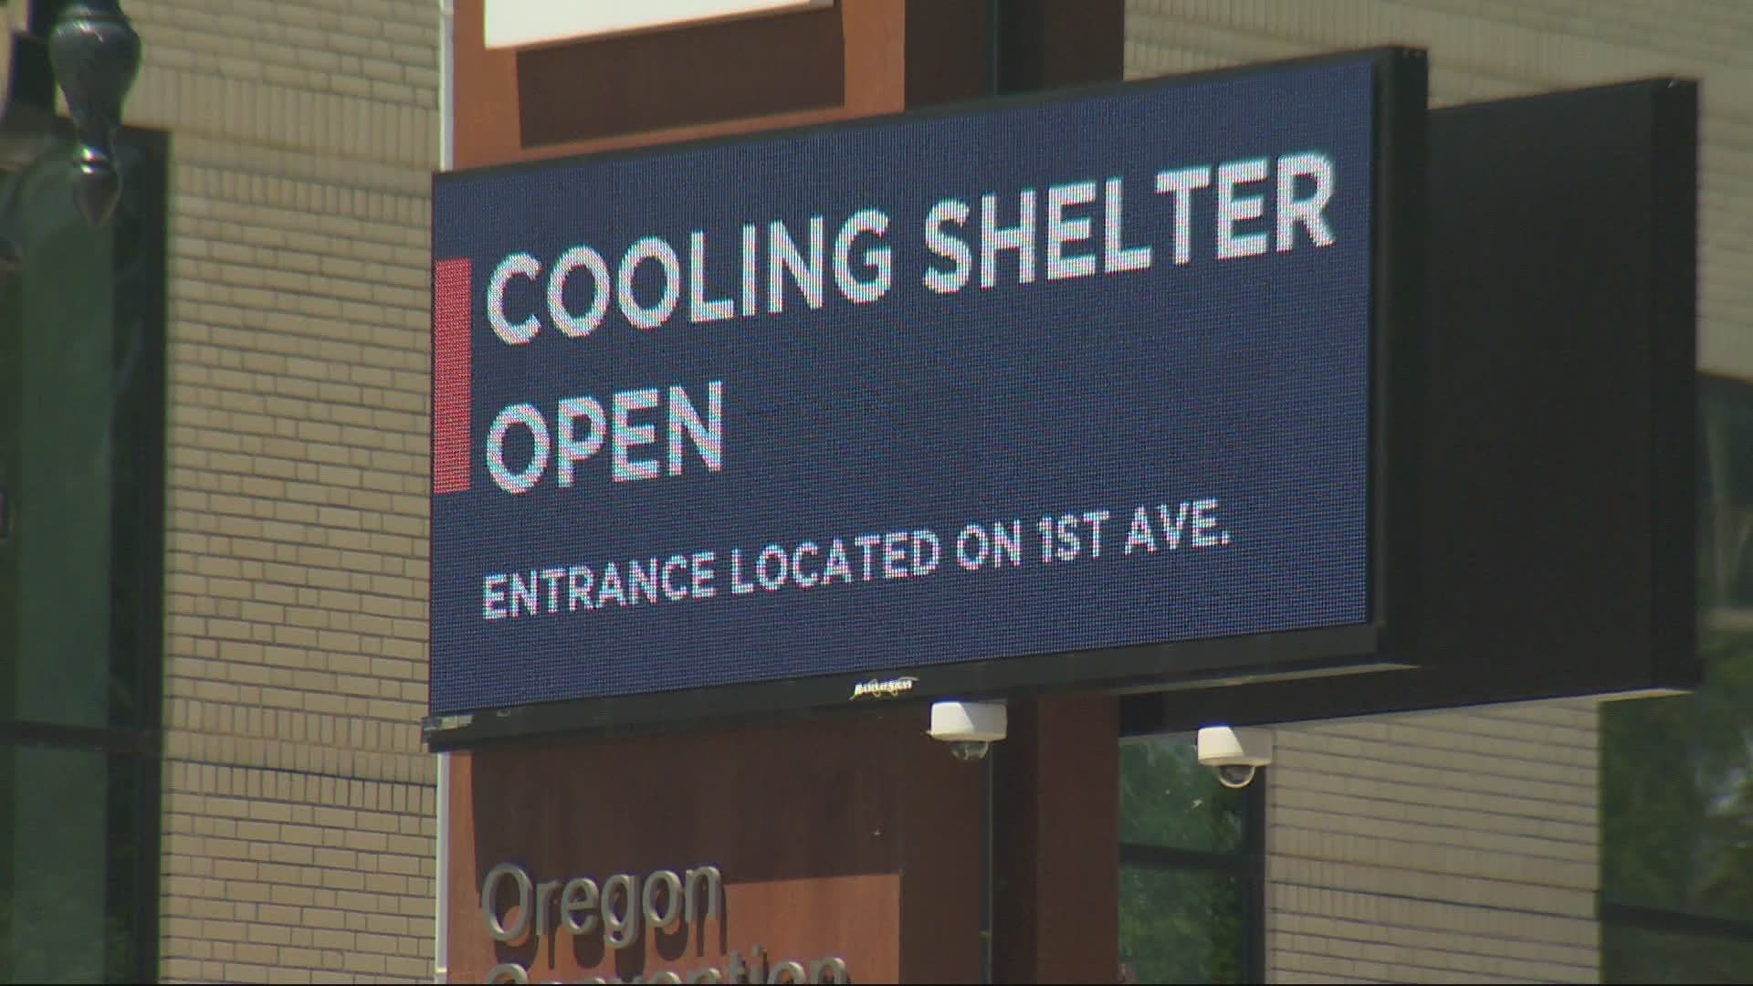
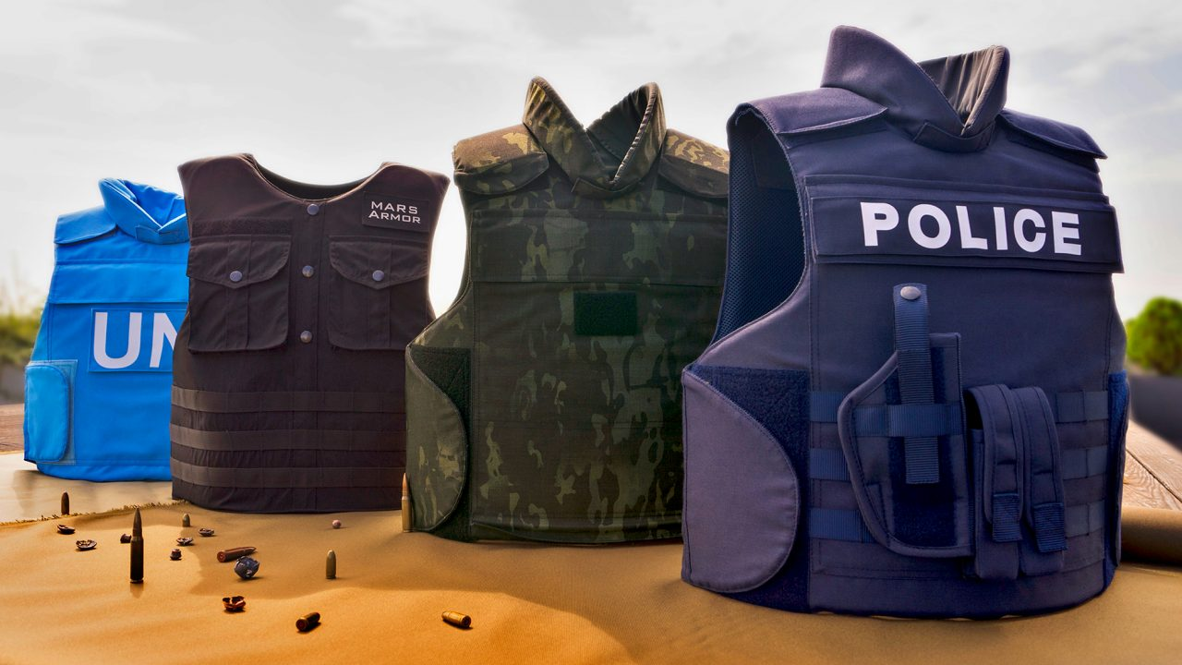
What is Harm Reduction?
A way for people to reduce risks with any activity
Notes:
Kathi
Harm reduction is a practice we use in all parts of life

Slide 14
What is Harm Reduction?
A set of practical strategies that reduce the negative consequences associated with drug use and sex work.
In relation to drug use, it incorporates a spectrum of strategies including safer use, managed use, abstinence.
Harm reduction strategies meet people "where they're at“ (but don’t leave them there).
Notes:
Kathi

Slide 15
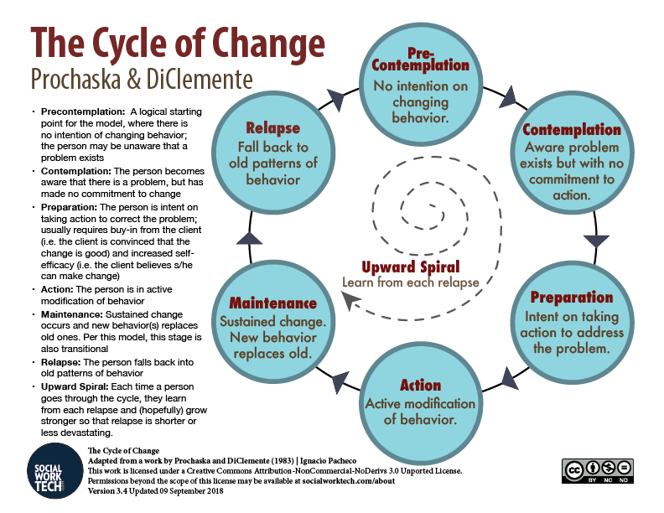
Stages of Change
Notes:
Kathi
Stages of change is a way Tapestry, most harm reductionists and SUD treatment providers think about SUD. In fact, it is a way of thinking about any type of behavior change.
Explain: Story of grandma’s toe

Slide 16
Harm Reduction Relationships
Start where the individual “is at” not where others want/think they should be
View drug use as a behavior that may cause harm
  Focus on harm(s), NOT drug(s)
Success = “any positive change”
Notes:
Kathi

Slide 17
Harm Reduction
Performed by Tapestry
Harm Reduction Sites
  Needle exchange
  Narcan distribution
  Drug board
  Drug testing
  STD testing
  Connection with harm reductionists
  Wound care
Harm Reduction Outreach/Van
  Same services offered at people’s homes or through a mobile site
Notes:
Kathi
To summarize, these are the harm reduction services provided by Tapestry. As much as we honor and value partnering with PD, remember, there are some things that folks who use drugs are not going to tell police that they are more willing to share with tapestry. They are probably not going to share how much they are using ect but they will with us which is why it can be so helpful to refer folks to us that are actively using

Slide 18
Harm Reduction
Performed by DART Officers
Use of Narcan to reverse an overdose
Targeted Narcan distribution to those most at risk
Information about not using alone
Information on risks associated with post incarceration and post detox
Referrals to other resources: Tapestry, DART recovery Coaches, Detox etc.
Notes:
Dave
Tapestry’s HR is inherently going to be different than police partly due to roles. Folks who are using can speak freely about illegal drug use to Tapestry without fear of any criminal sanctions in ways they will likely NEVER be able to do so with PD. Nonetheless, DART officers can still play a pivotal role in harm reduction and have been saving lives with interventions since the programs inception in 2017

Slide 19
Physiology of Addiction for DART
ACES FROM CHILDHOOD STRONGLY AFFECT LIKELIHOOD OF ADDICTION
Kindness and empathy
BRAINS THAT USE SUBSTANCES ARE DIFFERENT THAN BRAINS THAT ARE NOT USING SUBSTANCES
Harm Reduction Philosophy
Anti Stigma/Non Judgmental
PEOPLE USING SUBSTANCES LOSE CONTROL OVER SO MANY ASPECTS OF THEIR LIVES
Consent
Respect
Empowerment
Trauma informed
Notes:
I want to pull out the most important parts of that video for the DART program and connect it to DART values. From there we’ll take a break and when you come back, we’ll explore the details of each value more in depth.
ACES: if proclivity for SUD is determined by things that are out of ones control, DART really tries to understand that and approach people who are using drugs with curiosity and kindness. What’s this trauma informed thing? Trauma informed is just a recognition that many folks have trauma and you don’t know what it is so try to approach people with that understanding. Given the high aces we know people who use drugs have lots of childhood trauma. Then there is the trauma most folks experience from drug use. Please be kind.
Brains that Use Drugs are Different: Once you have started using drugs, it is so hard to stop. DART does two things in recognition of this fact.
1, harm reduction. Harm reduction is a series of practices that try to reduce the harm someone doing an unsafe behavior. Seat belt example. In SUD, harm reduction is Narcan.
Reduce stigma and shame. Shame and blame have no place and they aren’t helpful. If you shame someone for their substance use they will be less likely to seek help from you. Moreover, as Ari said, recovery is about fixing your brain and rejoining society so the more we shame and blame people the farther we push people out of society and into drugs.
Control: little control over urges, lose so much that we try to give folks back some control. We do it in a few ways: we try to ask as much as possible: may we come visit. Are you interested in a recovery coach. Fix power imbalances: first name.

Slide 20
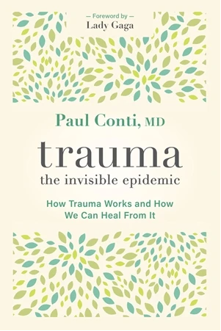
Trauma
“When people suffer from trauma, however, their threat sensors become hyperactive and hypervigilant- convincing them that things are dangerous and wrong, right now, constantly. It is like a threat sensor recognizes that it was unable to prevent the initial trauma and now it’s trying to make up for it by being active and loud all of the time.”
Paul Conte MD “Trauma, the Invisibe Epidemic”
Notes:
Kathi
Include trauma physiology- include withdrawal as trigger. Also wd grouped with trauma- example prison or homelessness and safety
Child example… stuck in trauma
Human trafficking/prison

Slide 21
Trauma Informed Care
These key elements:
(1) realizing the prevalence of trauma;
(2) recognizing how trauma affects all individuals involved with the program, organization, or system, including its own workforce;
(3) responding by putting this knowledge into practice
From: SAMHSA, Trauma and Justice Strategic Initiative, 2012
Notes:
-kathi

Slide 22
Trauma Universal Precautions
Be aware of impact of trauma
Emphasize safety
Offer opportunity for control/ work collaboratively
Emphasize strengths rather than weaknesses
Hopper, Bassuk, & Olivet, 2010
Notes:
Dave: mention what he does in the field to give control. Narration
Universal precautions!!

Slide 23
DART Trauma Informed Strategies
ACTIONS
Voice Volume
Mindful of Approaching from Behind
Understanding
Every behavior makes sense in the context of a persons life
Be curious
Language
Mindful of Touching w/o consent
Narration of physical contact
Notes:
Review and expand on slide

Slide 24
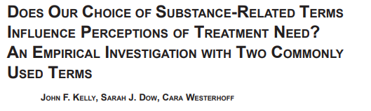
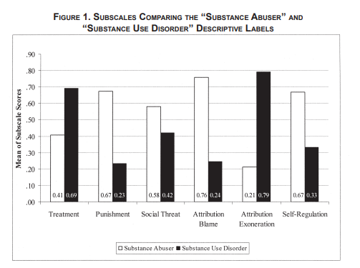
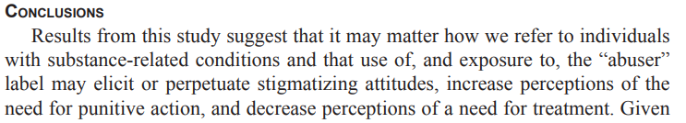
Language Matters
Notes:
Kathi

Slide 25


Language Matters
SAY THIS:
NOT THIS:
  Language is powerful —especially when talking about addictions. Stigmatizing language perpetuates negative perceptions.
  “Person-centered” language focuses on the person, not the disorder.
Person with a substance
use disorder
Person living in recovery
Person living with an addiction
Person arrested for drug violation
Chooses not to at this point
Medication is a treatment tool
Had a setback, resumed use
Maintained recovery
Positive drug screen
Addict, junkie, druggie, abuser
Ex-addict or reformed addict
Battling/suffering from
an addiction
Drug offender
Non-compliant/bombed out
MAT is replacement addiction
Relapsed
Stayed clean
Dirty/failed drug screen
Notes:
Kathi
We don’t work in the ED so what are some ways that DART officers can fight stigma? A big one is language

Slide 26
Empowerment
Notes:
Kathi

Slide 27
Empowerment
Commons challenges of chaotic use
Health Challenges
$ problems
Employment challenges
Relationship challenges
Housing Instability
Legal Challenges
Notes:
Kathi
Before we talk about empowering folks with SUD who we are working with, we need to discuss why it is so important. What’s going on for most folks who are using that they need this power
I know PD’s aren’t the most talkative but let‘s see if we can generate a list of challenges you see with folks who are using substances problematically
If we remember Ari’s video and what we’ve discussed once you are addicted, it’s very hard to stop so though these seem like surmountable challenges, they don’t feel that way for someone whose brain is addicted. The experience of SUD is often loss of choice, you have to use and deal with all the challenges that come with it.
Unfortunately most folks someone who is using substances interacts with doesn’t understand the addicted brain like you all and blames them for these challenges. And what comes with blame? Shame? (story of ES)
People in every one of these sphere will likely blame them for causing their own problems yet they don’t feel like they have a choice
Now everyone in this room except me and Kathi are officers and you have rules to follow most of which you don’t have choices. Our DART officers follow the law, but they try to give power back to folks in the areas that they can. What are those areas:

Slide 28
Empowerment Continued
Reduce Power Imbalance
Ask for consent when you can
Give people the choice to keep using
Notes:
DaveYou guys have a lot of power. I work with the PD and my heart races when I see an officer and I fear I did something wrong. Remember that (trauma informed) Our DART officers all use their first names with folks as an effort to reduce the power inbalance and to demonstrate respect
Folks with SUD have lost so much power, something simple as asking if you can come back to check on someone goes a long way. In that same fashion, our RC’s are voluntary and if folks do not want them, we accept that
As hard as it is to see someone who is suffering, we cannot make someone find recovery. That truly is their own choice. Harm reduction acknowledges that power they have and tries to keep them alive

Slide 29

NO ONE CAN FIND RECOVERY FOR SOMEONE ELSE
Trauma Informed
Empowerment
Harm Reduction
Notes:
DAVE
Some folks get frustrated with DART. They say “the person didn’t get better. They went back to problematically using substances or never stopped” and here is the hard truth: no one can find recovery for another person. As much as you want to. They have to want it for themselves. We can do lots of things to support them (as discussed) but we cannot make someone find recovery.

Slide 30
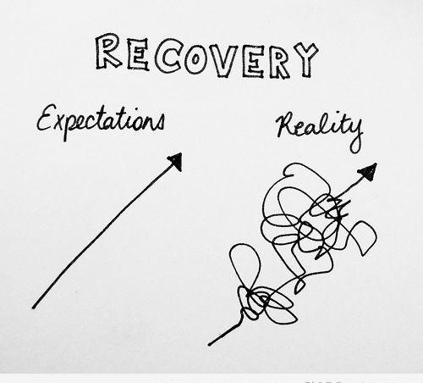
The Road of Recovery is……..
Notes:
Dave
All change is hard (refer to harm reduction story) but recovery is harder than most changes because of the physiology of addiction. I think it’s important to take a moment to review what recovery looks like for most people and why many folks are not ready to change. Our job and all we can do is support people, be kind and help people stay alive till they are ready to try to change.
It’s also really important to note that most people you have interacted with SUD have tried to change their behavior at least and part of recovery is in fact reoccurrence. Remember that as well when you encounter someone who is using.

Slide 31
Commons Recovery Paths
Crisis
CSS
Crisis Stabilization Services
TSS
Transitional Support Services
Sober Housing
Re-Entry into ‘community at large’
ATS/Detox
?Abstinence?
Crisis
Outpatient/Community services + supports
?Abstinence?
MOUD
Reoccurrence
Notes:
Dave
Section 35

Slide 32
Commonly Used DART Officer Resources
Narcan Use and Distribution
Opioid Naive Education
Never Use Alone
PD Harm Reduction
Recovery Coaching
Tapestry
Refer
Learn to Cope
SADOD (Support After a Death by Overdose)
Family Support
MA SUD Hotline
FaceBook
Detox
MA SUD Hotline
CBHC (Community Behavioral Health Center)
MAT
Notes:
-You do not need to know all the resources but it is good to be a bit familiar with some particularly because RC (the biggest resource) are not usually available same day and sometimes folks are asking for some same day help.
-IF you forget everything, when in doubt, call the SUD hotline
-A word about the booket: it is overwhelming. We do not suggest you distribute

Slide 33
Questions/Comments/Concerns

Slide 34
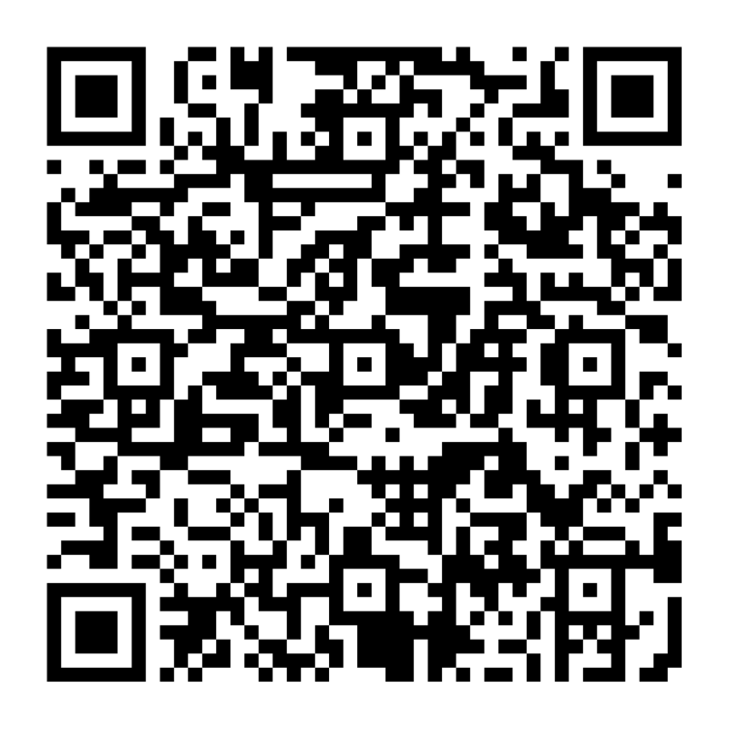
Thank you for all you do for DART and for your community!
Notes:
Put a QR code on the slide and ask them to take quiz

